Slide 1
Photo Gallery of e-Hall beamline and Darklight
experiment area
December 20, 2021

Slide 2
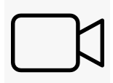
This set of photos was taken on December 20, 2021, to give a detailed picture
of the environment around the current (downstream) and future (upstream)
locations of the Darklight target chamber. Many structures, such as pipes and
cable trays, which are not shown in the CAD drawings, are visible in these photos.
Many photos have some combination of a tape measure and
a home-made meter stick, to allow dimensions to be inferred.
To avoid foreshortened views of objects far from the centre of each frame
(see red lines below), photos were taken at 5 different locations (A to E) along
the beamline. The most uniform linear scale will be obtained when the object in
question is directly beneath the camera.
E
D
C
B
A
beam
direction

Slide 3
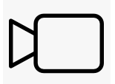

At each of the 5 locations, photos were taken from 5 different orientations, as shown below.
Photos from the “Overhead” position were taken with a cellphone camera and a selfie stick
while standing on the nearby elevated platform.
Overhead
Right-diagonal
far
Right-diagonal
near
aluminum frame
for Helmholtz coils
Right
Left
beam coming
out of the
page

Slide 4
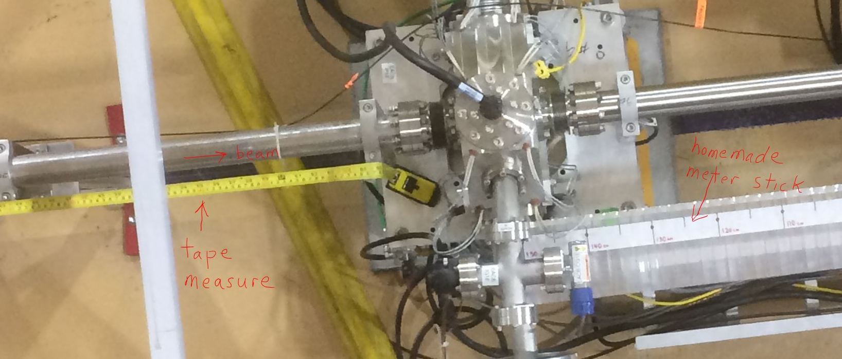
Two different rulers were placed at beam height to give a measure of the linear scale:
a tape measure (imperial/metric), and a home-made meter stick with markings at
5 cm and 10 cm separations, as shown below:
A sequence of pictures was also taken with the rulers placed on the floor, instead of
at beam height, to allow parallax-free measurements of distances of objects on or
near the floor, e.g. cable trays.

Slide 5
The following list tabulates the set of 55 photos:
01 Locations A B C D E on the overhead platform at which the overhead photos were taken
02 Longitudinal view of beamline with corresponding locations A B C D E marked
03 Longitudinal view of beamline without annotations
04 Overhead view, upstream half of beamline, with annotations
05 Overhead view, downstream half of beamline, with annotations
07-11 Overhead views, locations A-E, with tape measure upstream and meter stick downstream
12-16 Overhead views, locations A-E, with meter stick upstream and tape measure downstream
17-21 Overhead views, locations A-E, no rulers, unimpeded view
22-26 Right views, locations A-E, no rulers
27-31 Right diagonal close views, locations A-E, no rulers
32-36 Right diagonal far views, locations A-E, no rulers
37-41 Left views, locations A-E, no rulers
42-46 Right views, locations A-E, rulers on the floor instead of on the beampipe
47, 48 Tape measure showing the height of the beampipe from the floor
49, 50 Two views of the Darklight target chamber in its (Dec 2021) downstream position
51, 52 Two views of the future upstream position of the Darklight target chamber
53-56 Pictures showing the heights of the bottom and top Helmholtz coils from the floor
For orientation, most photos have a green arrow indicating the beam direction.

